Slide 1
Why Python?
Lakshmi Priya

Slide 2
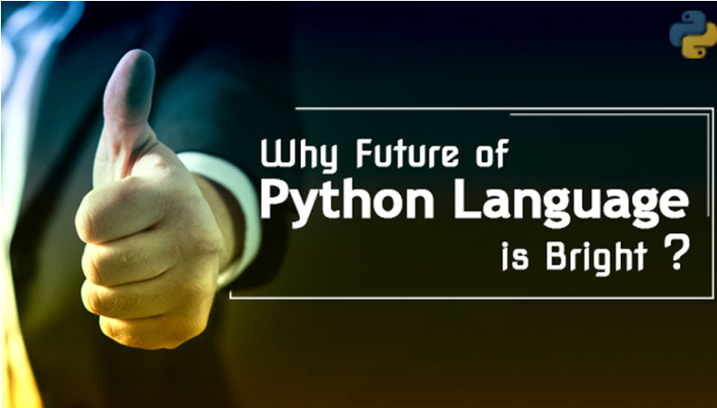

Slide 3
Python is a High Level Programming Language

Slide 4
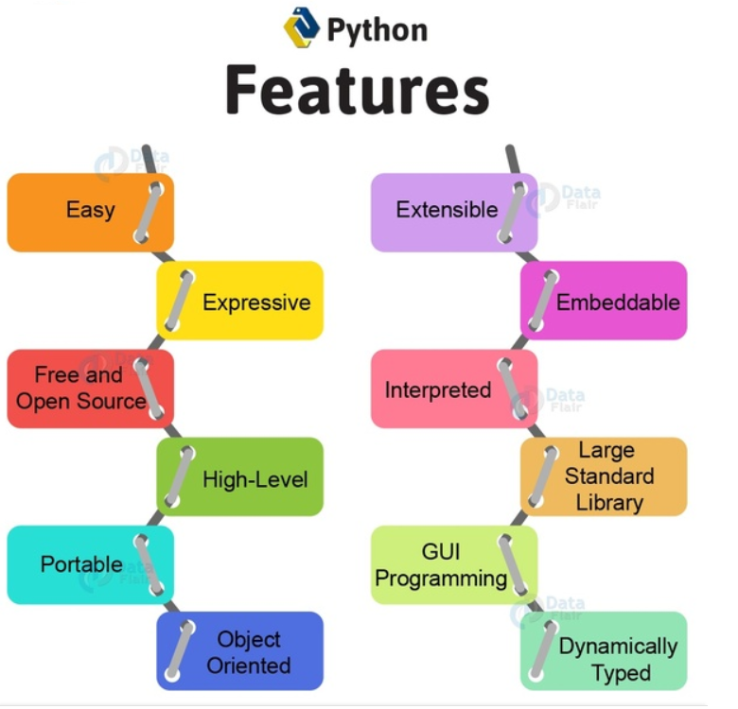

Slide 5
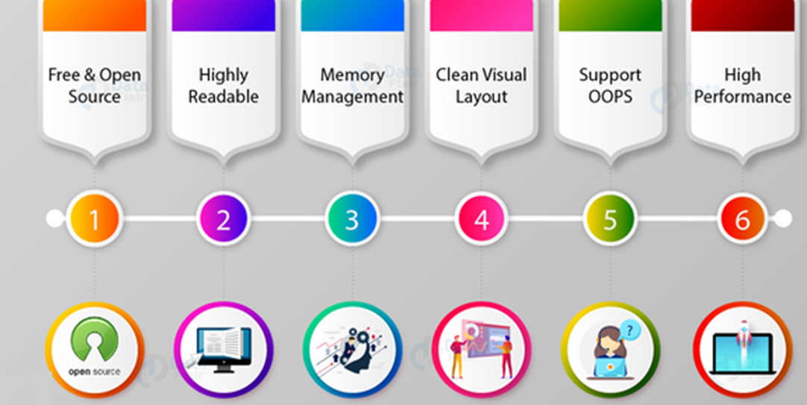

Slide 6
Python Features
Easy to write/read
Python is easier to code than other popular languages like Java and C++.
Python code is quite like English.
Looking at it, you can tell what the code is supposed to do.
Expressive
Python provides us with different ways of writing code that helps us to focus on the solution rather than the syntax.

Slide 7
Free and Open Source
Python is freely available. You can download it from the following link https://www.python.org/downloads/
It is open-source. This means that its source code is available to the public. You can download it, change it, use it, and distribute it.
High Level
High-level source code contains easy-to-read syntax

Slide 8
Portable
Python can run equally on different platforms such as Windows, Linux, Unix and Macintosh etc.
Object Oriented
A programming language that can model the real world is said to be object-oriented. It focuses on objects, and combines data and functions.
Python supports both procedure-oriented and object-oriented programming which is one of the key python features.

Slide 9
Extensible
Python code can be written in other languages like C++.
This makes Python an extensible language, meaning that it can be extended to other languages.
Embeddable
It is also possible to put our Python code in a source code in a different language like C++.
This allows us to integrate scripting capabilities into our program of the other language.

Slide 10
Interpreted
Python is an interpreted language i.e. interpreter executes the code line by line at a time. This makes debugging easy
Large Standard Library
Python downloads with a large library that you can use so you don’t have to write your own code for every single thing.
GUI Programming
Graphical user interfaces can be developed using Python.
Dynamically Typed
It is not necessary to specify a variable type while declaring it.
The type for a value is decided at runtime, not in advance.

Slide 11
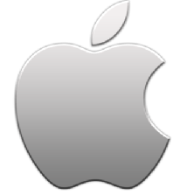
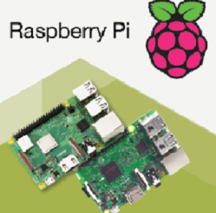
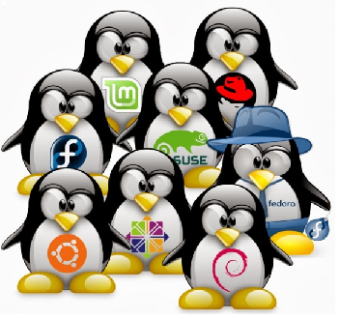
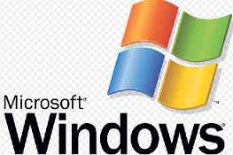
Python
is Portable

Slide 12
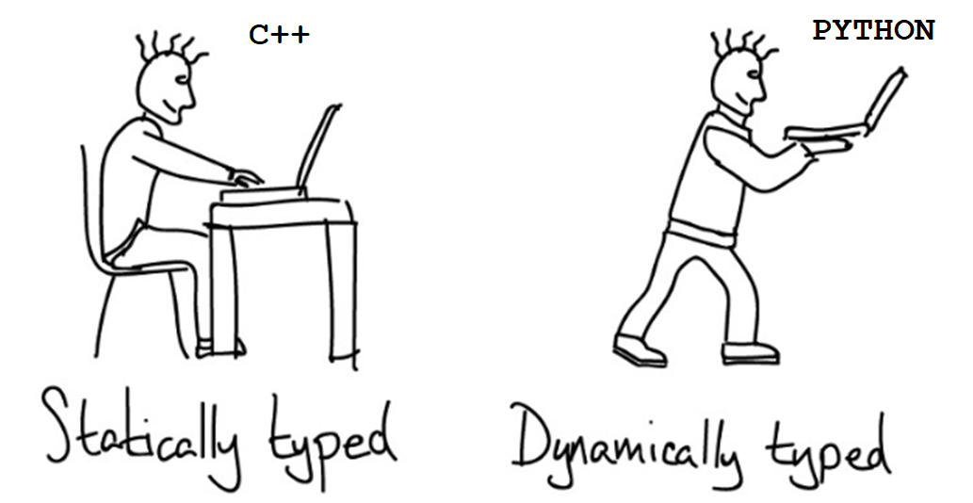

Slide 13
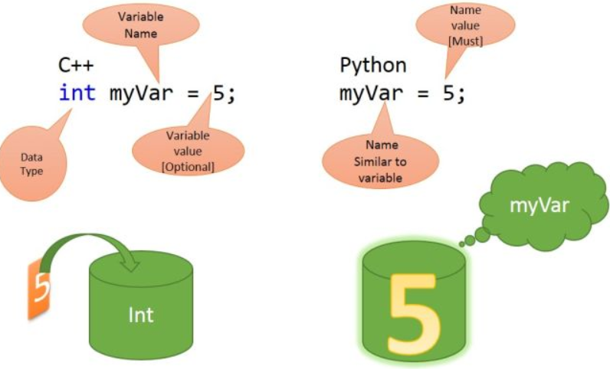

Slide 14
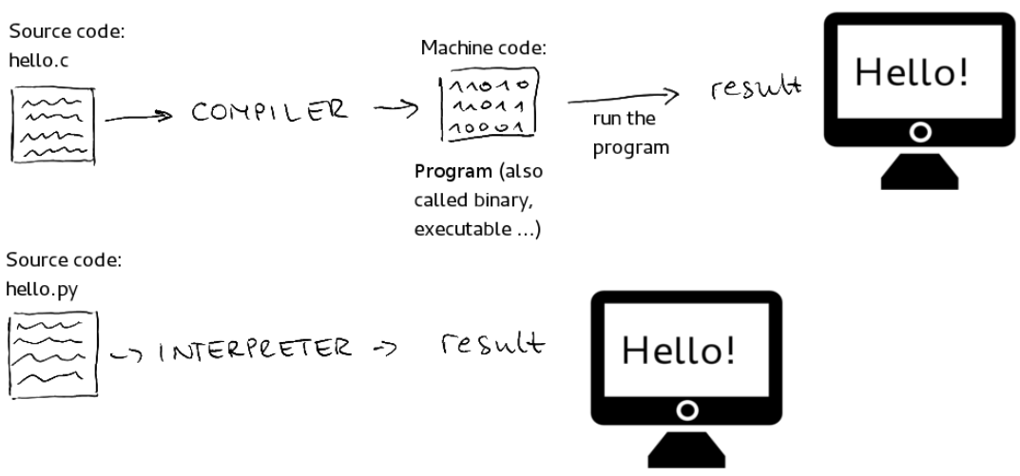
Python is interpreted language

Slide 15
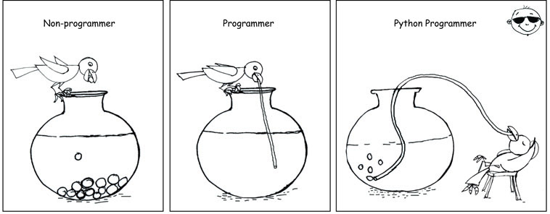

Slide 16
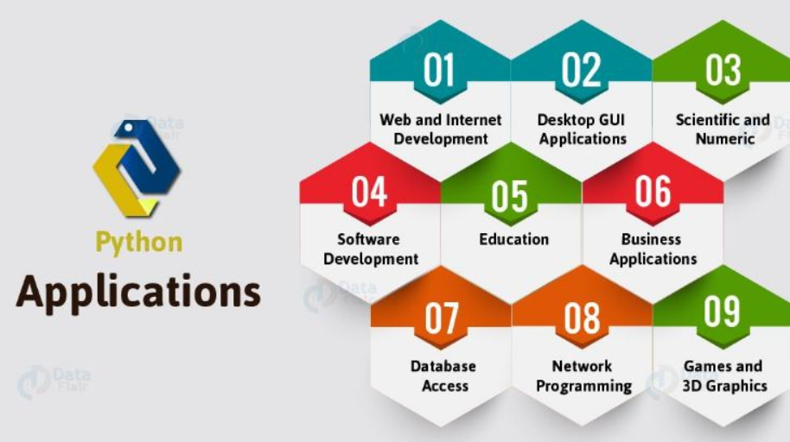

Slide 17
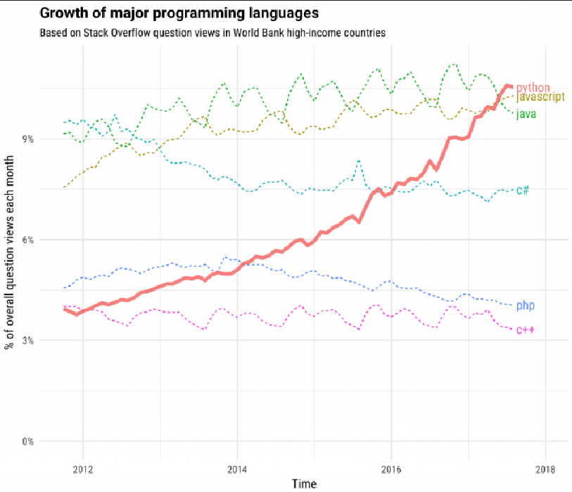
Popularity of Python

Slide 18
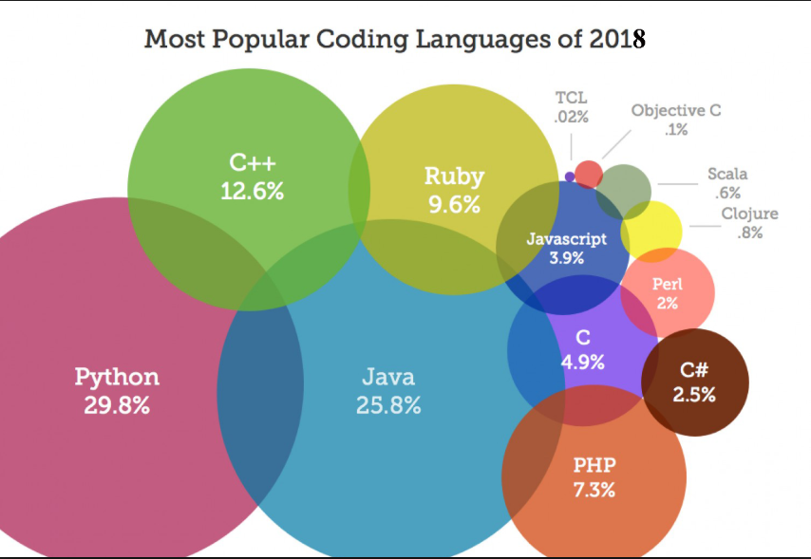

Slide 19
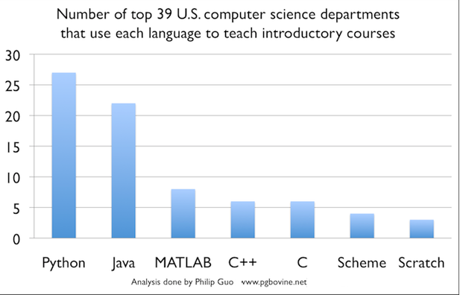

Slide 20
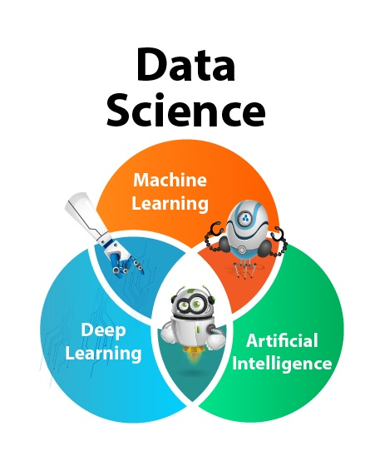
Data Scientists Love Python

Slide 21
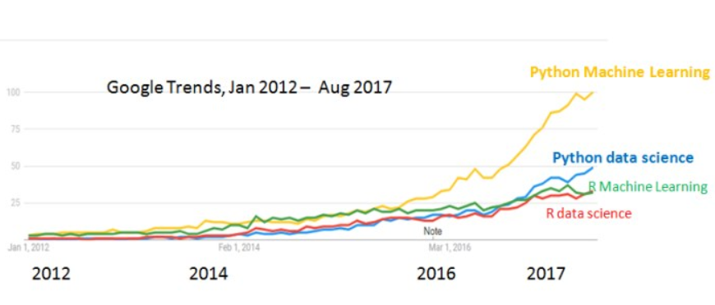
Who is ahead in Data Sciences?

Slide 22
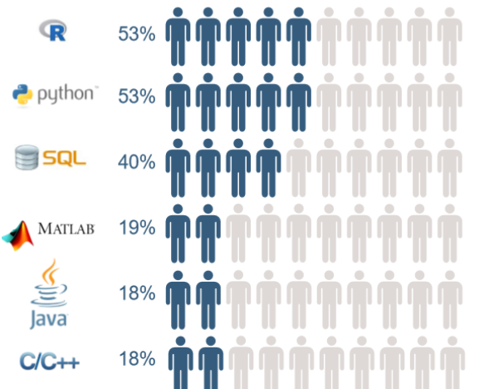
Skills required to become a data scientist

Slide 23
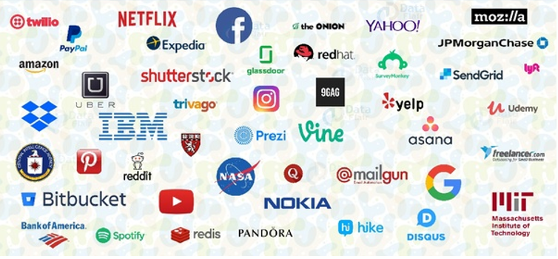
List of few companies who are using Python

Slide 24
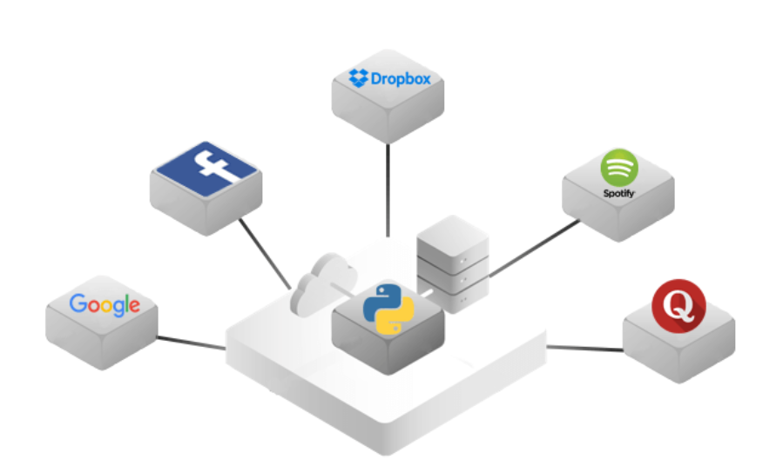
Top Companies that built their websites with Python Framework

Slide 25
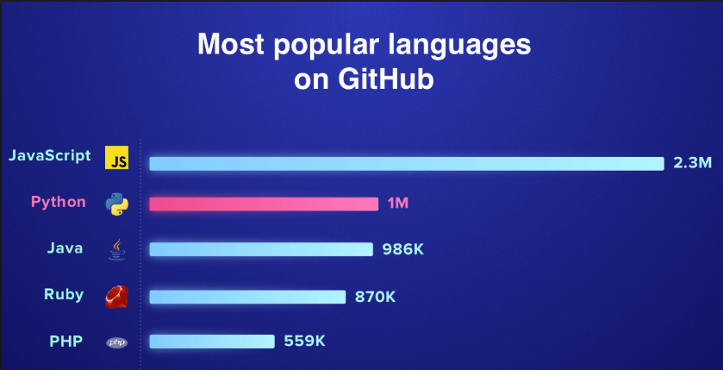
Most Popular Languages on GitHub

Slide 26
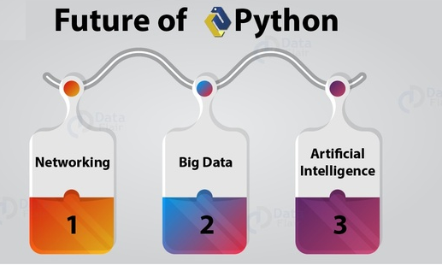
Technologies that rely on Python Today and Tomorrow

Slide 27
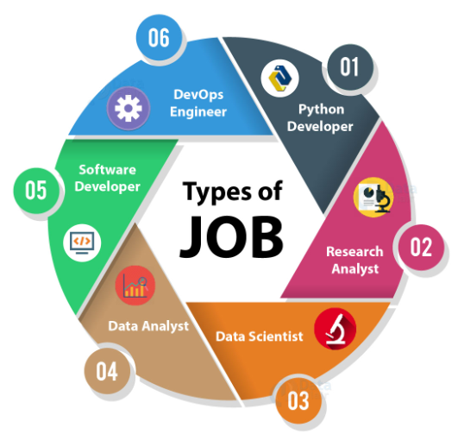
PYTHON CAREER OPPORTUNITIES

Slide 28
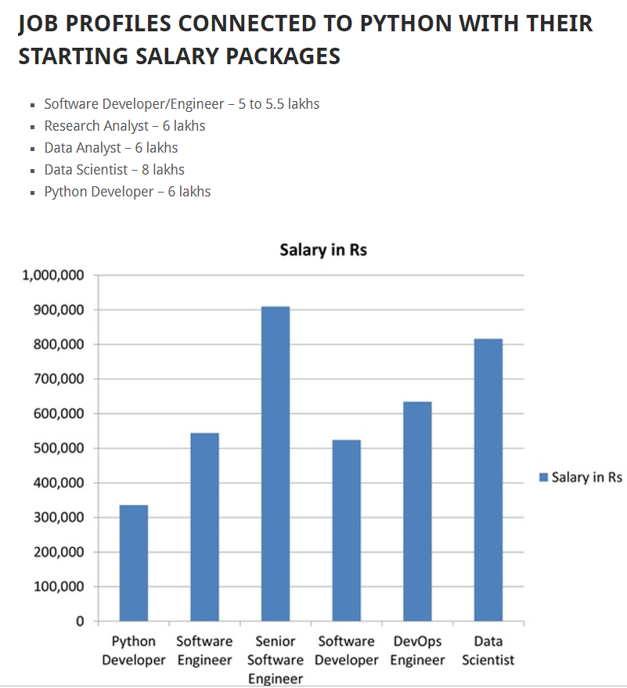

Slide 29
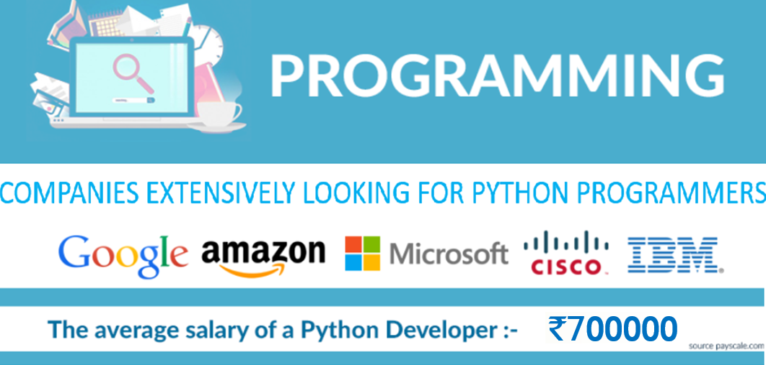

Slide 30
